Slide 1
ELM - "no runtime exceptions technology"
Lukasz Gąsior

Slide 2





Łukasz Gąsior
gasior.net.pl
@lukaszgasior
JSUpskill

Slide 3
Agenda
Język
Ekosystem
The Elm Architecture
Demo

Slide 4
elm
Język funkcyjny kompilowany do JavaScript
+ framework
2012 by Evan Czaplicki
Aktualna wersja 0.18
Instalujemy przez npm
http://elm-lang.org

Slide 5
elm
Strong static types
No runtime errors
No nulls
No undefined is not a function
Immutability
Friendly error messages

Slide 7
funkcje
isNegative n =
n < 0
isNegative 4

Slide 8
funkcje
isNegative n =
n < 0
isNegative 4
isNegative (-3 * -4)

Slide 9
currying
add x y z =
x + y + z
add 1 2 3
6 : number

Slide 10
currying
add x y z =
x + y + z
add 1 2

Slide 11
currying
add x y z =
x + y + z
add 1 2
<function> : number -> number

Slide 12
currying
double n =
n * 2
doubleNumbers list =
List.map double lists

Slide 13
currying
double n =
n * 2
doubleNumber list =
List.map double lists
doubleNumber =
List.map double

Slide 14
piping
add 1 (multiply 2 3)
sum (filter (isOver 100) (map getCost records))

Slide 15
piping
add 1 (multiply 2 3)
3
|> multiply 2
|> add 1
add 1 (multiply 2 3)
3
|> multiply 2 3
|> add 1 (multiply 2 3)

Slide 16
piping
sum (filter (isOver 100) (map getCost records))
records
|> map getCost
|> filter (isOver 100)
|> sum
records
|> map getCost records
|> filter (isOver 100) (map getCost records)
|> sum (filter (isOver 100) (map getCost records))

Slide 17
typy
add : Int -> Int -> Int -> Int
add x y z =
x + y + z
isTrue : Bool
isTrue = True
map : (a -> b) -> List a -> List b
List.map

Slide 18
tuples
val1 = (1,2)
val2 = (1,True,'a',[])
Tuple.first val1

Slide 19
records
point =
{ x = 3, y = 4 }
type alias Point =
{ x : Int
, y : Int
}
func1: Point -> Bool

Slide 20
records
user=
{ name = “Lukasz”, isActive= True }
type alias User =
{ name : String
, isActive : Bool
}
.name user
Users
|> List.map .name

Slide 21
records - immutable
user=
{ name = “Lukasz”, isActive= True }
disable user =
{user | isActive = False}

Slide 22
union types
type List =
Empty
| Node Int List

Slide 23
Maybe
type Maybe a
= Just a
| Nothing

Slide 24
Maybe
divide : number -> number -> Maybe Float
divide x y =
if y == 0 then
Nothing
else
Just (x / y)

Slide 25
Maybe
case divide 6 3 of
Just n ->
“Result is ” ++ (toString n)
Nothing ->
“No Result”

Slide 26
Maybe
case divide 6 3 of
Just n ->
“Result is ” ++ (toString n)
ERROR!!!

Slide 27
Ekosystem
elm-make
elm-repl
elm-package
elm-reactor

Slide 28
elm-make

Slide 29
elm-make

Slide 30
elm-make

Slide 31
elm-make

Slide 32
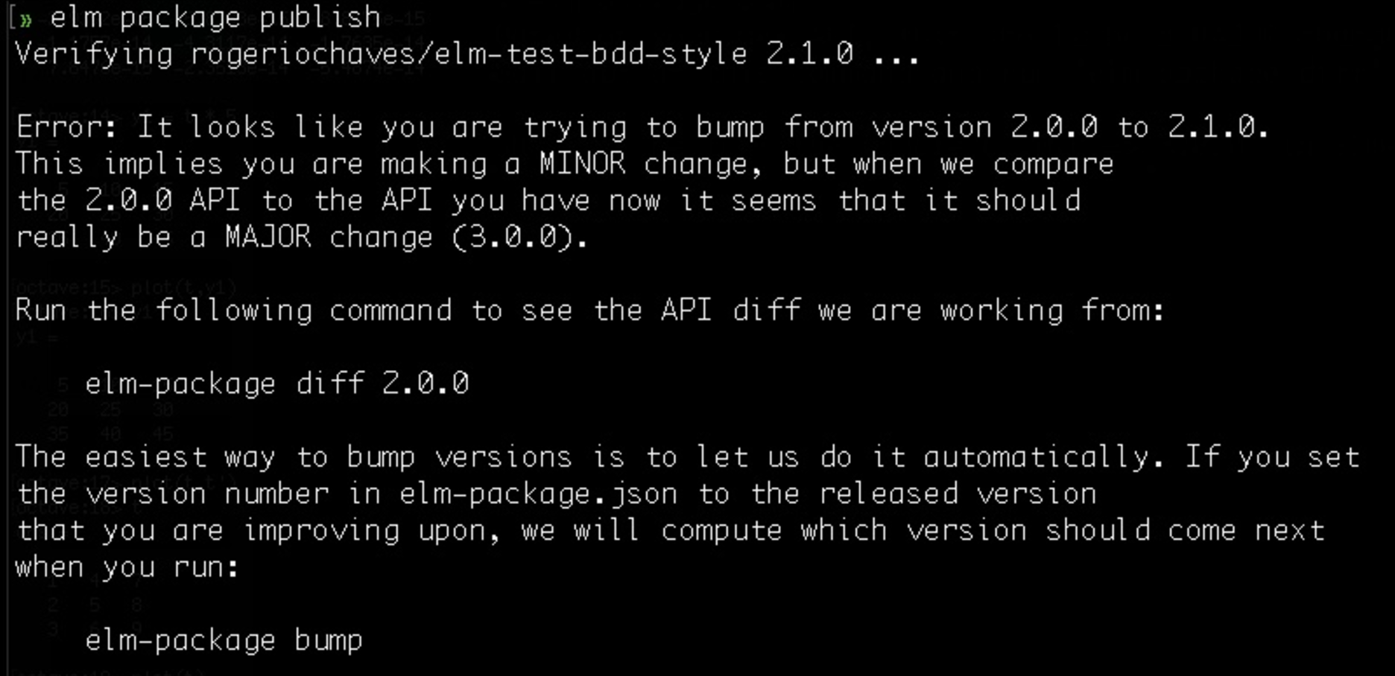
elm-package

Slide 33
The Elm Architecture

Slide 34
DEMO

Slide 35
Dziękuję za uwagę!
Łukasz Gąsior
@lukaszgasior
http://gasior.net.pl

